Slide 1
Cell Design

Slide 2

Other Modules In This Series:
5S
Standard Work
Total Productive Maintenance (TPM)
Administrative Lean
Cell Design/ Production Preparation Process (3P)
Kaizen
Kanban
Problem Solving
Poka Yoke Quality Systems
Transaction Process Improvement (TPI)
Cause & Effect Diagram with the Additions of Cards (CEDAC)
Single Minute Exchange of Dies (SMED)
Value Stream Mapping (VSMi®)
Visual Management
Managing Daily Process Excellence
For More Information Please Contact:
Mark DeLuzio, President and CEO
+1.860.234.0915
mark.deluzio@leanhorizons.com
Strategically Creating Value Through the Elimination of Waste

Slide 3
This document contains confidential
and proprietary information owned
by Lean Horizons Consulting, LLC.
Any disclosure, use, copying or
distribution of this information without the express written consent of Lean Horizons Consulting is strictly prohibited.

Slide 4
Ground Rules for Event
Safety first (use personal protective equipment)
Active participation by all
Start and end on time
All electronic gadgets (phones, pagers, etc) turned to “off” or “silent”
Computers to be used only when instructed
Keep an open mind to change
Don’t let “perfect” get in the way of “better”
Notes:
DO: Perform Group Introductions. Pick an ice-breaker or exercise to warm the team up to the event. (Icebreaker Example: Everyone uses their name tent and writes a “Personal License Plate” in which they have 2 minutes to creatively use a total of 7 letters or numbers to tell us something about themselves. Examples “LV2SAIL” OR “DADOV5”
DO: Review Event Ground Rules.
ASK: “Does anyone have any rules they would like to see added?”
ASK: “Does everyone agree to these?”

Slide 5
Goal of Cell Design Module
To apply the principles and components of proper Cell Design
to achieve a target goal for your business.
Key Concepts
of
Cell Design
Steps to
Designing
a Cell
Building
Quality
Into the
Cell
Do’s and
Don’ts
of Cell Design
Notes:
DO: Introduce the notion of Cell Design and the goal of this event.
SAY: “The major objectives of this module are that we want you to:
1 – Understand the key concepts of Cell Design
2 – Identify the steps to designing a cell
3 – Identify how to build quality into the cell
4 – Define what are the do’s and don’ts of Cell Design”

Slide 6
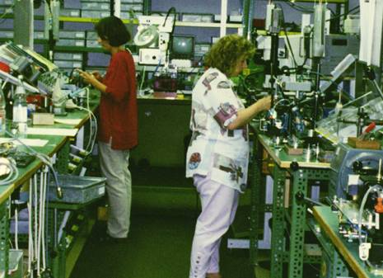
Cellularization
An arrangement of equipment, people, machines, and methods that facilitate continuous flow production
Allows for one-piece flow whenever possible
One operator can process the entire part when needed
Usually grouped by either product family or process
Popular configuration is “U” Shaped
Notes:
DO: Define for the class what we mean by a cell or a cellular arrangement.

Slide 7
Cellularization fundamentally reduces all of the 8 wastes
Benefits to Cellularization
Less inventory (improved quality)
Minimizes walking
Promotes better work balance (lower cost)
Enables multi-process handling
Promotes better communication
Staffing flexible as demand changes
Scheduling and manning assignments easier
Easier to manage
4
3
5
2
6
1
Notes:
SAY: “Cellularization both in the office and factory fundamentally reduces all of the 8 wastes.”
DO: For each of the benefits ask the group if they have an example or can explain how cellularization fulfills that benefit.

Slide 8
Exercise: Cell Design Charter Review
Objective
Review the Cell Design Charter for the event against charter criteria
Instructions
Time to Complete
As a team review the event charter and answer the
following questions:
What is the business need for this event?
Who is the owner?
What are the goals for this event?
30 minutes
Deliverable
Make any modifications
to charter as necessary.
Notes:
DO: Review the charter for this event.

Slide 9
Key Concepts of Cell Design
Key Concepts of Cell Design
Steps to Designing a Cell
Building Quality into the Cell
Do’s and Don’ts of Cell Design
Objectives:
Differentiate between batch production, flow production, and “fake” flow production
Review characteristics of cellular flow
  Counterclockwise flow
  Machines in close proximity
  Operator Flow vs. Part Flow
  Separate operator from machine
Define chaku-chaku and levels of automation
Notes:
DO: Review chapter objectives.

Slide 10
One Piece Flow Production in a Cellular Layout
Key Concepts of Cell Design
Product Flow in a Cellular Plant Layout
Significantly reduces:
  Transportation
  Inventory
  Waiting time
While improving:
  Quality
  Delivery
  Cost
Final Assembly
Testing
Wave Solder
Packing
PC Board Assembly
Customer
Raw Material
Notes:
DO: Define one-piece flow.

Slide 11
Batch Production
Key Concepts of Cell Design
INVENTORY
Notes:
DO: Review what is happening on the slide and what we mean by “batch production.”
ASK: “What wastes do you see on this slide with batching?”

Slide 12
Flow Production
Key Concepts of Cell Design
Waste
CUSTOMER
RM
RM
Notes:
ASK: “What wastes have been eliminated by moving to one piece flow?”

Slide 13
Fake Flow Production
Key Concepts of Cell Design
CUSTOMER
RM
RM
Notes:
ASK: “What do you see happening in this graphic?”
ASK: “Why is this not single piece flow?”

Slide 14
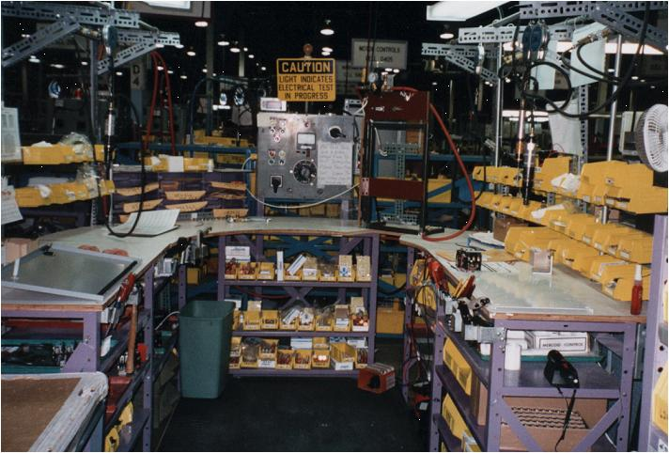
Example of Cellular Flow
Key Concepts of Cell Design
Notes:
ASK: “Here is a picture of a manufacturing cell. What are some characteristics that you see?”

Slide 15

Why Counterclockwise?
Key Concepts of Cell Design
Cellular Flow is Typically Counterclockwise
Designed to pull with the right hand and then pass to the next process with the left hand
This method takes into account that the right hand is the dominant hand
for most.
Reprinted with permission from BigPhotoStock.com
Notes:
DO: Discuss why cellular flow is typically counterclockwise. Ask if it would make sense to ever challenge that? (answer: yes – where it makes sense to do so – with lean there are very few absolutes, you have to apply it to your situation).

Slide 16
Machines in Close Proximity
Key Concepts of Cell Design
Operator runs 3 machines to produce a part
Shear
Punch
Lathe
25’
15’
215 Pieces
Daily Production ___________
Feet per shift ___ _________
Feet Per (240 days) year ____________
Miles (5280 ft.) per year ____________
17,200
4,128,000
782
Notes:
NOTE: For a possible drawing on a chartpaper: Draw a picture with the three operations and show how the distances will be shorter in a u-shape even if the distances remain the same, the backtracking is reduced by being in a u.

Slide 17
Cellular Flow
Key Concepts of Cell Design
Operator Flow vs. Part Flow
Operator and part follow the same sequence
R
5
4
3
2
1
6
7
8
9
10
F
Notes:
SAY: “In this case, the operator and part follow the same sequence.”

Slide 18
Cellular Flow
Key Concepts of Cell Design
Operator Cellular Flow vs. Part Flow
Operator does not flow the same as the part
4
3
2
1
R
2
1
3
2
1
3
4
4
5
6
5
6
8
F
7
Notes:
SAY: “Here is another work sequence combination where the operators do not flow the same as the part. Note, Operator #1 retrieves the raw material completes steps 1,2 7,8 and deposits the finished product into the finished goods container. Operator #2 completes steps 3,4 5 & 6 in this work sequence.”

Slide 19
Cellular Flow: Separate Operator from Machine
Key Concepts of Cell Design
1 OPERATOR, 1 MACHINE
1 OPERATOR, MULTIPLE MACHINES
Notes:
SAY: “A key lean concept of cellular flow is to separate the operator from the machine.”
ASK: “What do you think we mean by this?”
SAY: “We want to remove as much non-value added activity from the operator as possible. How many people stand and watch their washing machines wash the clothes at home? We don’t do that at home, why would we want to do that at work? As much as possible we want to look for opportunities to free the operator from one machine to be able to work multiple machines/processes.”

Slide 20
To Automate or Not to Automate?
Key Concepts of Cell Design
Level | Cycle | Unload | Load | Transfer
1 | Manual | Manual | Manual | Manual
2 | Auto | Manual | Manual | Manual
3 | Auto | Auto | Manual | Manual
4 | Auto | Auto | Auto | Manual
5 | Auto | Auto | Auto | Auto
Level 3 = Ideal State (Chaku-Chaku)
Notes:
DO: Review the levels of automation and how we try to kaizen the process in this sequence.

Slide 21
Chaku-Chaku
Key Concepts of Cell Design
Means “load-load”
Operator should flow continuously from operation to operation spending less than 1-2 seconds per operation
A operator simply loads the part and moves on to the next operation
Automatic unloading of the workpiece (hanedashi)
The workpiece is oriented at unload
All operator movement in one plane (no reaching)
Notes:
DO: Define chaku-chaku.

Slide 22
Steps to Designing a Cell
Key Concepts of Cell Design
Steps to Designing a Cell
Building Quality into the Cell
Do’s and Don’ts of Cell Design
Objectives:
Identify the steps to designing a cell
Review examples of each step
Notes:
DO: Review section objectives on slide.

Slide 23
Steps to Designing a Cell
Steps to Designing a Cell
    Determine what the cell is to produce
Create cardboard cut-outs of the cell
Identify the workstation design
Determine the tool and material presentation
Define the material replenishment procedures
Notes:
DO: Provide brief overview of the steps to designing a cell.
SAY: “We will explain each of these in more depth on the upcoming slides.”

Slide 24
Steps to Designing a Cell
Steps to Designing a Cell
    Determine what the cell is to produce
Create cardboard cut-outs of the cell
Identify the workstation design
Determine the tool and material presentation
Define the material replenishment procedures
Notes:
SAY: “The first step is to determine what the cell should produce.”

Slide 25
Determine What the Cell is to Produce
Steps to Designing a Cell
Points Descriptions
Product Family
Analysis
A matrix tool to determine similarities of process steps and sequence.
The analysis sheet is the first step to determining what will be produced by the cell or cells
1
Benefits of
Product Family
Matrix
Shows model/volume relationship
Determines similarities
Can reduce the need for change-overs
2
Notes:
SAY: “We do this by conducting a product family analysis of all of the parts that are made and the processes they go through in order to be made. We look for similarities in order to identify product families. Groups of parts then make sense to be made together in a cell.”

Slide 26
Product Family Matrix
Steps to Designing a Cell
Product Family Matrix Example aka PQPR*
PROCESS NAME
Demand
Center
Gear
Part #
Quantity
% of Total
CNC Mill
Lathe
Grind
Roll
Clean
Teeth
Assembly
Packaging
Cutting
1
OBR-026
420
35

‚
ƒ
„
…
†
2
OBR-030
288
24

‚
ƒ
„
…
†
3
OBR-008
276
23

‚
ƒ
„
…
†
4
320147
84
7

‚
ƒ
„
…
†
5
330033
48
4

‚
ƒ
„
†
‡
…
6
330003
24
2

‚
ƒ
„
…
†
7
330030
24
2

‚
ƒ
„
…
†
8
320148
12
1

‚
ƒ
„
…
†
9
320087
12
1

‚
ƒ
„
…
†
10
OBR-004
12
1

‚
ƒ
„
…
†
TOTAL
1,200
100
Notes:
DO: Review this simple example.
DO: *Explain Product Quantity Process Routing from VSM and Standard Work.

Slide 27
Steps to Designing a Cell
Steps to Designing a Cell
    Determine what the cell is to produce
Create cardboard cut-outs of the cell
Identify the workstation design
Determine the tool and material presentation
Define the material replenishment procedures
Notes:
SAY: “Step 2 is to create cardboard cut-outs of the cell.”

Slide 28
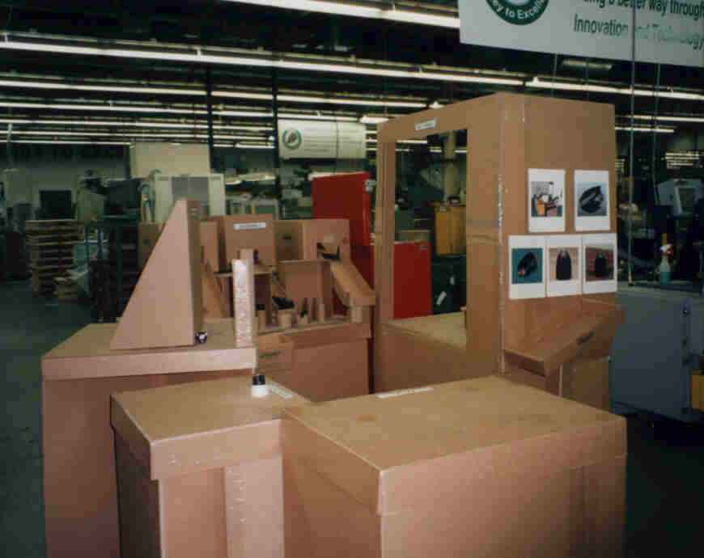
Creating Cardboard Cut-Outs
Steps to Designing a Cell
Cardboard Cut-Outs
A “footprint” of a cell using cardboard
cut-outs
Benefits:
  Cell can be designed and improved many times before moving machines
  Allows visualizing of the cell layout
  Involves everyone on the team
  Allows for multiple layout ideas
Notes:
DO: Define the cardboard cut out method and ask the group what the advantages would be.

Slide 29
Cardboard Cut-Out Method
Steps to Designing a Cell
Step 1
Step 2
Step 3
Step 4
Each machine or process step footprint is exactly replicated in a cardboard cut-out
Full size is used so people can readily visualize magnitude
In open area place “machines” in the flow you wish to try
Experiment with different layouts
Create multiple alternatives
Team-based
Watch for potential problems
Mark the operator load/unload point with red for visibility
Look at proposed design again for any problems
Select the best option
This should be a team consensus
Notes:
SAY: “A few additional notes on cardboard cut-outs…
Cut-outs may not be needed for simple “easy to move” operations.
If possible, have the host facility prepare cut-outs prior to the Kaizen event.
Make sure to stress that this is a team based exercise - operator involvement is critical
Watch for potential problems (barriers, reverse flow, etc.) or physical constraints (structural beams, posts, etc.)”

Slide 30
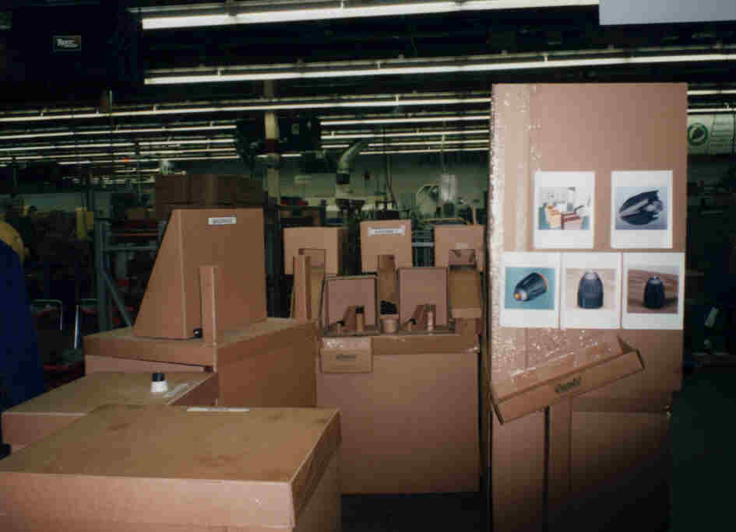
Example of a Cell Using Cardboard Cut-Outs
Steps to Designing a Cell
Notes:
SAY: “Here is another example of a cell designed by cardboard cut-outs.”

Slide 31
Steps to Designing a Cell
Steps to Designing a Cell
    Determine what the cell is to produce
Create cardboard cut-outs of the cell
Identify the workstation design
Determine the tool and material presentation
Define the material replenishment procedures
Notes:
SAY: “Step 3 is to identify the workstation design.”

Slide 32
Work Station Design
Steps to Designing a Cell
Size the workstation for the parts
Arrange the parts in the proper sequence and orientation
Standardize hardware and tools
Place fixtures and hand tools in order of use
Establish visual control of tools (shadow board)
Make machines fit the process
Optimize operator motions
Notes:
DO: Review key points on the slide.

Slide 33
Steps to Designing a Cell
Steps to Designing a Cell
    Determine what the cell is to produce
Create cardboard cut-outs of the cell
Identify the workstation design
Determine the tool and material presentation
Define the material replenishment procedures
Notes:
SAY: “Step 4 is to determine how the tools and materials are to be presented to the cell/operator.”
ASK: “Why is this important? What benefit is there to doing this?”

Slide 34
Tool and Material Presentation
Steps to Designing a Cell
Points Descriptions
Point of Use
Tools and materials located where they are needed
Operators should not have to reach, bend, or exert excess (wasted) motion to retrieve materials or tools required for an operation
1
2
Benefits of
good tool & material
presentation
Improve working ergonomics
Reduce walk time
Reduce cycle time my reducing unnecessary motion
Eliminates lost tooling
Improves safety
No searching for tools
Easier replenishment
Notes:
SAY: “Appropriate space needs to be allocated for tools and materials!”

Slide 35
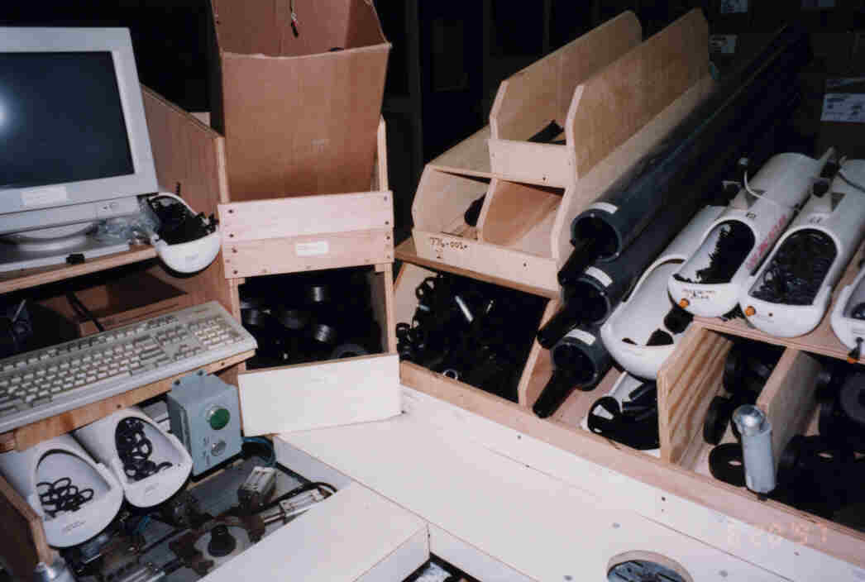
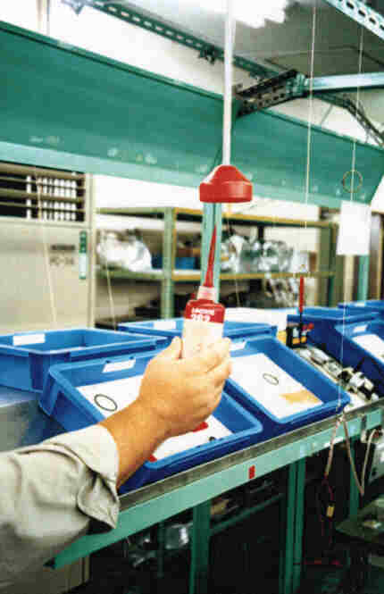
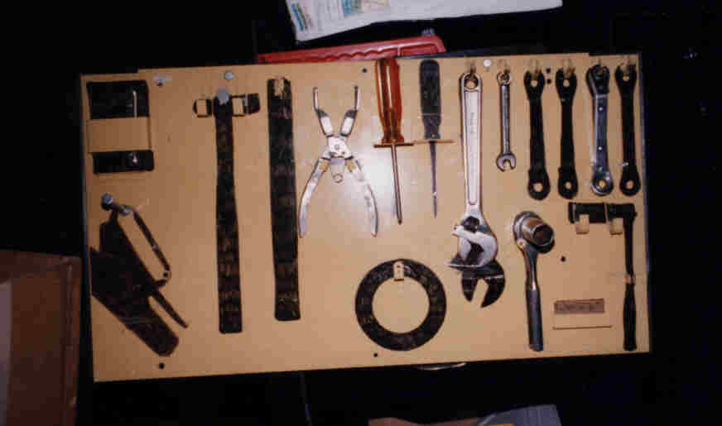
Material and Tool Presentation Examples
Steps to Designing a Cell

Slide 36
Steps to Designing a Cell
Steps to Designing a Cell
    Determine what the cell is to produce
Create cardboard cut-outs of the cell
Identify the workstation design
Determine the tool and material presentation
Define the material replenishment procedures
Notes:
SAY: “Step 5 is to define the material replenishment procedures, by this we mean what is the process around bring parts to the cell and taking completed parts/products away from the cell.”

Slide 37
Material Supply Principles
Steps to Designing a Cell
Resupply path
  Supply components from behind the line / outside the cell
Ergonomics
  No bending, stretching, twisting, or lifting
Organization of materials
  Labeled
  Assigned homes
  Arranged in order of use
  Foot printed
  Stored in only one location
Notes:
SAY: “It is important to choreograph the steps and sequence to how the materials will be supplied to the cell.”

Slide 38
Supermarkets
Steps to Designing a Cell
The supermarket is for storage
Use a water spider to supply the line
Replenish the line frequently - every hour
Remember -- it’s only an interim solution!
  The goal is to have suppliers ship just in time
Notes:
DO: Define supermarkets and cover key points on the slide.

Slide 39
Water Spider Characteristics
Steps to Designing a Cell
1
2
3
Definition
Purpose
Benefits
Individual(s) responsible for material replenishment to the cell(s)
Delivers in kits to the line
Delivery is JIT according to standard operations
Must utilize 5S principles to assure good visual controls
Allows operators to “operate”
  Eliminating material handling
  Searching for parts
  Walking to resupply
  Orienting parts
Improves quality by
  Establishing accountability for material presentation
  Reduces mismatches, use of wrong parts
  Manages production control
The role of Water Spider is key to consider when creating cell
Notes:
ASK: “Why wouldn't we just have the operator take care of replenishing their materials, why have another position for this?” (answer: by the operator doing this, they will have to stop making products, travel to retrieve the parts and then travel back to their cell. This breaks the flow)

Slide 40
Building Quality into the Cell
Key Concepts of Cell Design
Steps to Designing a Cell
Building Quality into the Cell
Do’s and Don’ts of Cell Design
Objectives:
Define “poka-yoke” and “jidoka”, and review everyday examples
Identify the four levels of error-proofing
Identify and review prevention and detection examples of error-proofing
Define 7 steps to error-proofing a process
Discuss importance of developing a Line Stop Support Plan
Identify process improvements when error-proofing is not possible
Notes:
DO: Review section objectives on slide.

Slide 41
Error-Proofing
Building Quality Into the Cell
1
2
3
Poka-Yoke
Jidoka
Examples
A Japanese term meaning, “mistake-proof”
A method of designing processes that will prevent errors
Also referred to as “autonomation”, means a method of transferring human intelligence to the process
The process detects abnormalities and stops when detected
Motion detect light switches room enter and exit
Car stops when object in path.
Auto shut-off irons
Automatic sinks in public restrooms
Low clearance barriers in parking garage
“Poka-Yoke” is the highest level of Jidoka
Notes:
ASK: “What are other error proofing examples?”

Slide 42
Error-Proofing
Building Quality Into the Cell
Level 1 - Customer Inspects
Rework
Level 2 - End of Line Inspection
A
B
C
Inspection
A B C
Ship
Scrap
Level 3 - End of Process Inspection
Level 4 - Perfect Quality Built In
A
B
C
Ship
Build in Quality
at Each Process
Notes:
DO: Review the 4 levels of error proofing.
ASK: “What is wrong with stopping at Level 2? (we are waiting until after the 3rd process to check if we have a quality part… steps B and C could be working on defect (WASTE – and if they are working in batch even more so!)
SAY: “We want to reach a point where it is impossible to pass a defect onto the next process. In this section will discuss ways to build quality into the product so that we can achieve this.”

Slide 43
Errors may either be prevented or detected
Building Quality Into the Cell
Technique | Prevention | Detection
Control (shut down) | An error is impossible | Defective item can’t move on to the next step
Warning | An error is about to be made | An error has been made
Notes:
SAY: “With error-proofing we can implement a control/shut down technique in the process – with prevention an error would be impossible, with detection, the defect would be unable to move onto the next step.
By implementing a warning technique, prevention methods would allow us to know that an error is about to be made, and detection methods would let us know that an error has just occurred.”

Slide 44




Control (Shutdown) Prevention and Detection Examples
Building Quality Into the Cell
Prevention
Detection
Access controlled by biometric scan
Vehicle won’t start unless in park and brake depressed.
Laundry dryers that have a device that shuts them down when overheating is detected
A computer spell checker
Reprinted with permission from BigPhotoStock.com
Notes:
DO: Review examples.

Slide 45

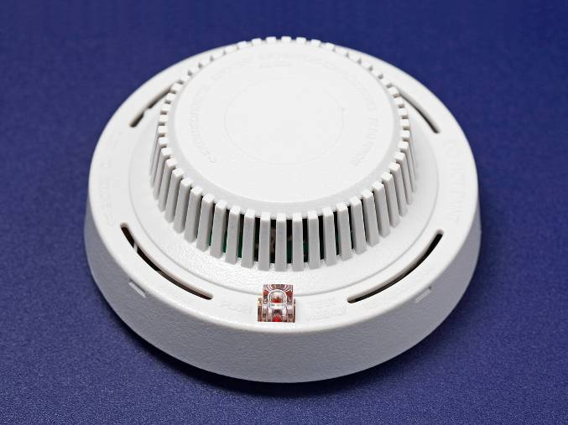
Warning Prevention and Detection Examples
Building Quality Into the Cell
Prevention
Detection
Warning systems in automobiles to alert driver that not all seatbelts have
been fastened
Smoke detectors
Reprinted with permission from BigPhotoStock.com
Notes:
DO: Review examples.

Slide 46
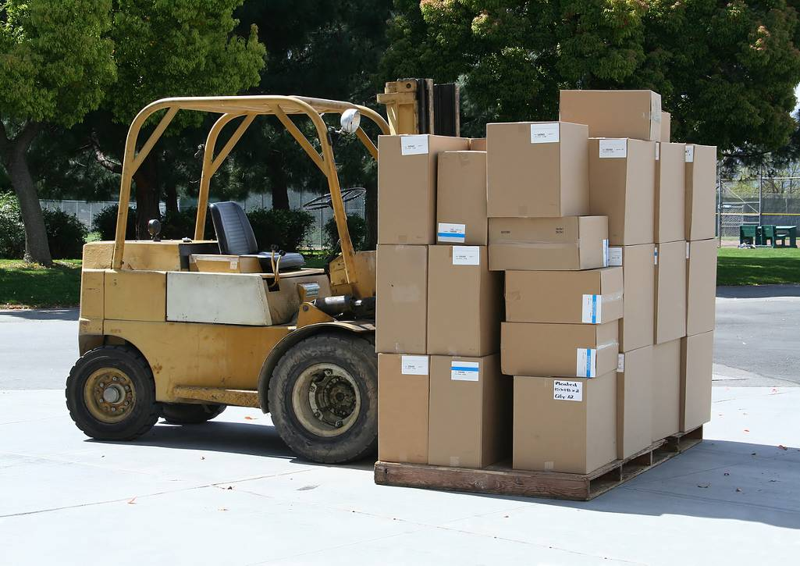
Error-Proofing Contact Methods
Building Quality Into the Cell
Contact Methods
Electrical outlets assure proper polarity – it is impossible to put a plug in the outlet incorrectly
Guide or guide pins that assure proper insertion
Magnetic contacts that assure proper positioning
Two handed start buttons to avoid hand accidents
Pressure sensitive mats that stop dangerous pinching machinery when someone steps onto the mat
Limit switches on fork trucks that prevent the truck from moving while the driver’s seat is unoccupied
Reprinted with permission from BigPhotoStock.com
Notes:
DO: Review examples.

Slide 47

Error-Proofing Fixed Value Methods
Building Quality Into the Cell
Fixed Value Methods
If four labels from different rolls are needed on each shipping box, put all the labels on one roll to make it easy to spot missed labels
Kitting is having the exact amount of material needed for one unit in one box. Makes it easy to catch missing components
Sensors that count parts as they are placed in a box
Scales to weigh packaging documentation and alert an operator to a missed document
Reprinted with permission from BigPhotoStock.com
Notes:
DO: Review examples.

Slide 48

Error-Proofing Motion-Step Methods
Building Quality Into the Cell
Motion-Step Methods
Place photo-electric switches into each component bin. Beam must be broken on each bin before conveyor will move
Motion sensors to stop a machine to prevent safety errors
Reprinted with permission from BigPhotoStock.com
Notes:
DO: Review examples.

Slide 49
7 Steps to Error-Proofing
Building Quality Into the Cell
Create a process map and identify the locations at which the defects are
found and made
Evaluate current procedures for adequacy and determine if they are
being followed
Identify defect provoking conditions at each process step
Identify the root cause(s) (error) of each type of defect and in which process step it occurs
Identify the type of error-proofing device required
Create the device and try it
Measure for effectiveness
Notes:
DO: Review the seven steps.

Slide 50

Develop a Line-Stop Support Plan
Building Quality Into the Cell
Line-Stop Support Plan
Establish line stop response assignments
Identify who does what when the line is stopped
Operators, Supervisors, Managers, etc.
Reprinted with permission from BigPhotoStock.com
Notes:
SAY: “For detection methods and warning methods, it is important that a plan is in place and well practiced for what to do if the line needs to be stopped. Everyone needs to know who does what, and they need to be counted on to do their part so that the process can be trusted.”
ASK: “What happens in an andon environment when an operator flips the switch to red, and no one responds… he/she ultimately has to go get the supervisor…”

Slide 51
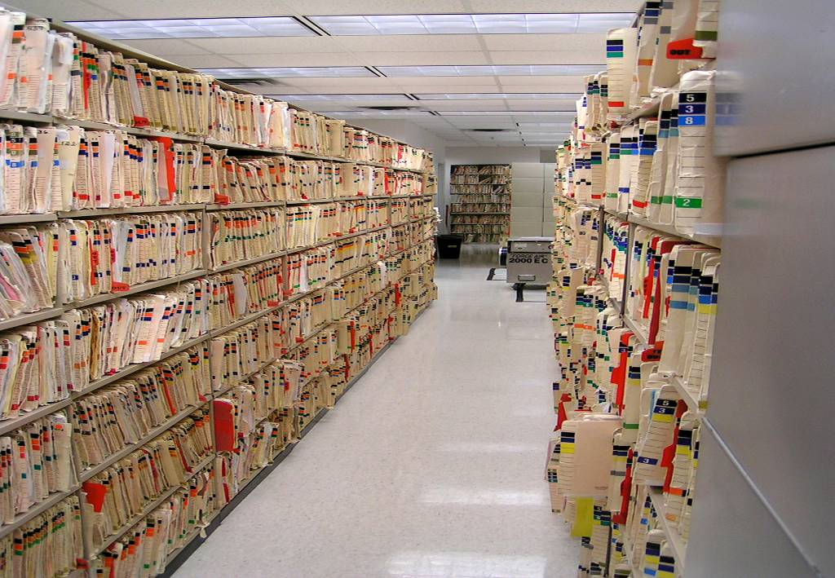
When you can’t error-proof –
Improve Visual Management.
Building Quality Into the Cell
Use colors and color-coding
  Filing
  Credit card receipts
Use shapes
  Notch a stack of forms so it is easy to tell if forms are out of order
Make it easy to do it right
  Checklists
  Effective data collection formats
  Workflow with fewer hand-offs
  Symbols
Reprinted with permission from BigPhotoStock.com
Notes:
SAY: “Error-proofing is not always possible given the process or what can be reasonably implemented during the improvement period. This slide shows some great ideas for making the process “better” in these instances.”
SAY: “With each of these examples, is it possible to pass on a defect? Yes. However, the chances are much less.”

Slide 52
Error-Proofing Summary
Building Quality Into the Cell
Error-Proofing devices can
  Prevent errors from occurring
  Detect the error after it occurred
  Detect the defect after it has been made
The best error-proofing devices are
  Simple and cheap
  Part of the regular process
  Close to where the error is made
Notes:
DO: Review summary points.

Slide 53
The “Do’s and Don’ts” of Cell Design
Key Concepts of Cell Design
Steps to Designing a Cell
Building Quality into the Cell
Do’s and Don’ts of Cell Design
Objectives:
Review and discuss each of the Do’s and Don’ts of Cell Design
Complete review of key learnings from Cell Design
Notes:
OPTIONAL EXERCISE:
PURPOSE: To provide an interactive experience for the learners to help remember the Do’s and Don’ts of Cell Design.
MATERIALS NEEDED: Markers and chartpaper
DO: Break the class into small groups and divvy up each of the “do’s and don’ts”. Ideally you could assign each slide to a different table or group.
INSTRUCTIONS: Each table or group must come up with an icon, drawing, or graphic that represents that particular principle. Have them draw this on a chart paper with markers and report out to the rest of the group. Set a brief time limit to encourage creativity (plus the time crunch makes it more fun!). Recommended no more than 5 minutes.
DO: As you review each of the drawings, take that time to really discuss what is meant by this principle with the group.

Slide 54
The “Do’s and Don’ts” of Cell Design
Do’s and Don’ts of Cell Design
DO | DON’T
Bring the part back to the operator | Design one-way machines
Keep height of all items in the workplace very low | Avoid waste of motion and any potentially unsafe reaching
Ask “why” and challenge what may have always been traditionally accepted | Assume that you need to limited by using certain machines
Use ideas | Unnecessarily use money
Notes:
DO: Discuss each in detail.

Slide 55
The “Do’s and Don’ts” of Cell Design
Do’s and Don’ts of Cell Design
DO | DON’T
Use equipment to permit one unit flow | Think in terms of batching
Utilize safe and easy-to- service machines and equipment | Utilize old, outdated machines that may be potentially unsafe or difficult to service
Think “flexible” and “responsible” machines | Don’t think “super-machines” or “all-in-one machines”
Think one-piece flow | Think batch production
Notes:
DO: Discuss each in detail.

Slide 56
The “Do’s and Don’ts” of Cell Design
Do’s and Don’ts of Cell Design
DO | DON’T
Add value to the product continuously through the process | Incorporate waste into the process
Think “bare bones” and add options when necessary | Incorporate machines with unneeded accessories
Get your hands dirty! | Be a catalog engineer!
Design machines to be narrow, deep and closely spaced together | Design machines with wide frontages spread far apart
Notes:
DO: Discuss each in detail.

Slide 57
The “Do’s and Don’ts” of Cell Design
Do’s and Don’ts of Cell Design
DO | DON’T
Make machines easy to detach and relocate | Do not design machines with “roots and vines”
Use shuttles to allow throw-in loading with auto-ejection (hanedashi) | Loose sight of opportunities to eliminate non-value added activities for the operator
Notes:
DO: Discuss each in detail.

Slide 58
Review Exercise
Do’s and Don’ts of Cell Design
2 Minute Review
In pairs, or in small groups, spend 5 minutes discussing key learnings and take-aways from this Cell Design Event thus far
One person from each group will share one learning that was discussed with the rest of the class

Slide 59
Other Modules In This Series:
5S
Standard Work
Total Productive Maintenance (TPM)
Administrative Lean
Cell Design/ Production Preparation Process (3P)
Kaizen
Kanban
Problem Solving
Poka Yoke Quality Systems
Transaction Process Improvement (TPI)
Cause & Effect Diagram with the Additions of Cards (CEDAC)
Single Minute Exchange of Dies (SMED)
Value Stream Mapping (VSMi®)
Visual Management
Managing Daily Process Excellence
For More Information Please Contact:
Mark DeLuzio, President and CEO
+1.860.234.0915
mark.deluzio@leanhorizons.com
Strategically Creating Value Through the Elimination of Waste

